Slide 1

Hobbs
jhobbs@valorem.com
Notes:
Purpose of this presentation: Power BI Modelling
Target audience: Analysts, Report Builders

Slide 2
AGENDA
9:00-9:15 Introductions
9:15-9:45 Module 1
9:45-10:00 Lab 1
10:00-10:15 Break | Q&A
10:15-10:45 Module 2
10:45-11:00 Q&A
11:00-11:30 Module 3
11:30-12:15 Break | Q&A
12:15-12:45 Module 4
12:45-1:00 Lab 4
1:00-1:30 Module 5
1:30-2:00 Final Q&A

Slide 3
Pre-Requisites
Internet Connection
Teams
Power BI Desktop
Dashboard-in-a-Day prior participation
Downloaded Class Files
NOTE: This lab is using real anonymized data and is provided by ObviEnce LLC. Visit their site to learn about their services: www.obvience.com .
This data is property of ObviEnce LLC and has been shared for the purpose of demonstrating PowerBI functionality with industry sample data. Any uses of this data must include this attribution to ObviEnce LLC.
Notes:
If you choose to put your class files in a different folder than noted on the slide, update the path in the FullPath parameter.

Slide 4
COURSE OBJECTIVES
By the end of this course, you will be able to use DAX to create calculations in a Power BI Desktop data model. Specifically you will be able to:
Understand basic concepts of Data Modeling
Understand the consequences of data model design decisions
Understand concepts of calculated columns and measures
Gain familiarity with standard DAX patterns & CALCULATE
Understand evaluation contexts and their impact on calculations
Gain ability to parse data modeling formulas

Slide 5
COURSE AGENDA
 |  | Introductions and Overview
Module 1 |  | Data Modeling Basics & Power BI Desktop Internals
Module 2 |  | DAX Calculated Columns & Measures
Module 3 |  | CALCULATE
Module 4 |  | DAX Evaluation Contexts
Module 5 |  | Data Modeling: Time Intelligence Functions
 |  | Wrap-up & Questions

Slide 6
Module 1
Data Modeling Basics &
Power BI Desktop Internals

Slide 7
MODULE 1 OBJECTIVES
Understand what is meant by data model in the context of Power BI
Understand the consequences of data model design decisions
Understand Power BI’s data storage architecture and use this knowledge to optimize performance
Understand consequences of Power BI’s data type handling

Slide 8
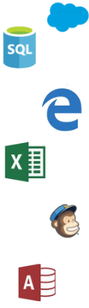

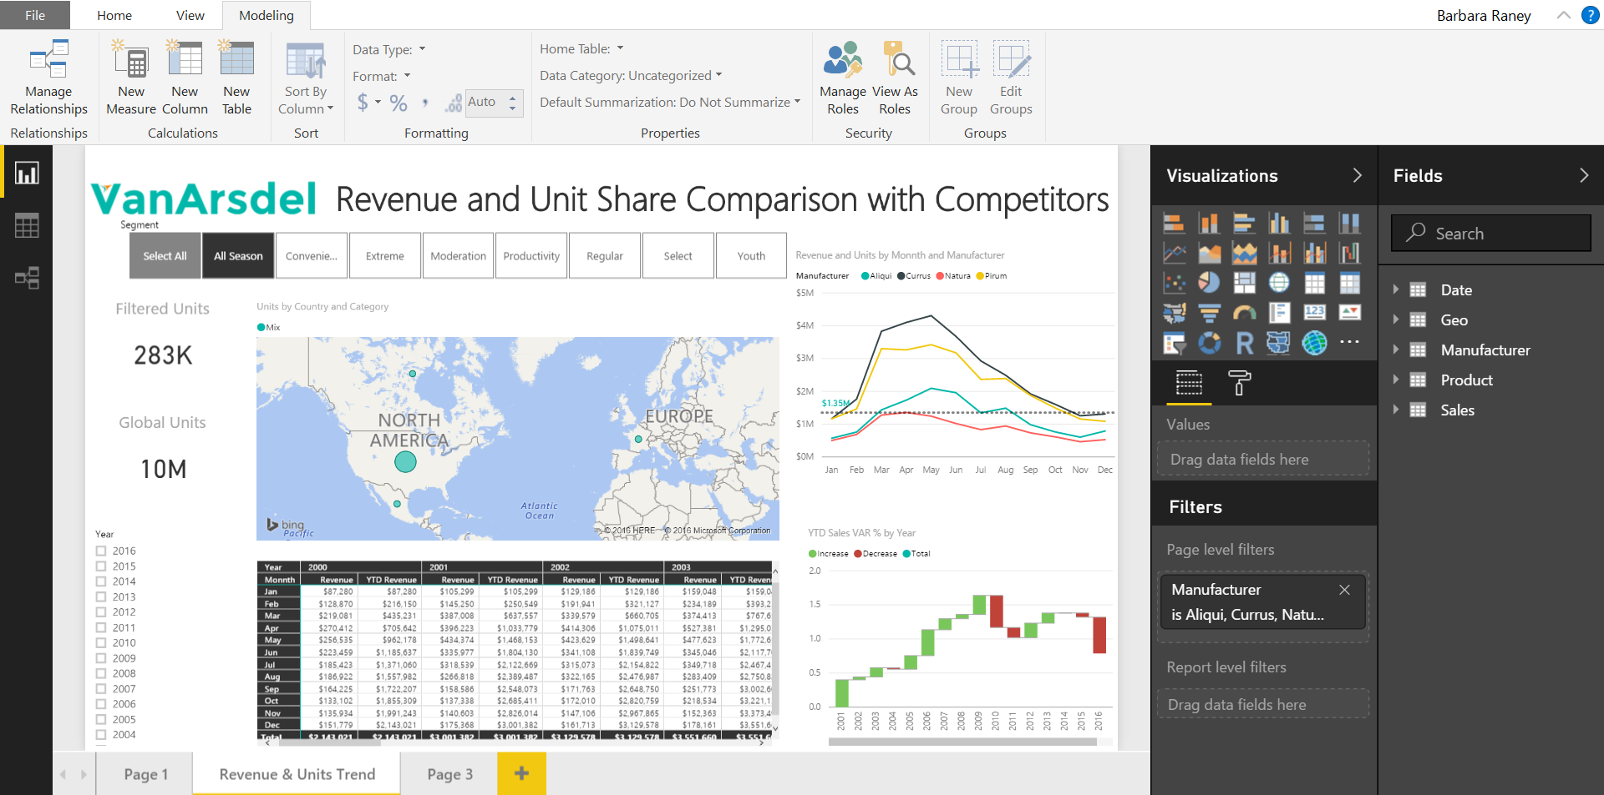
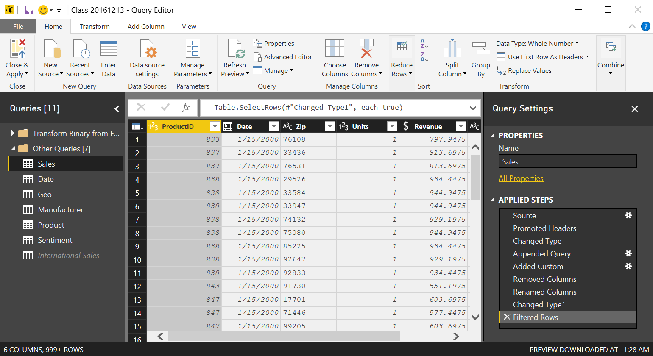

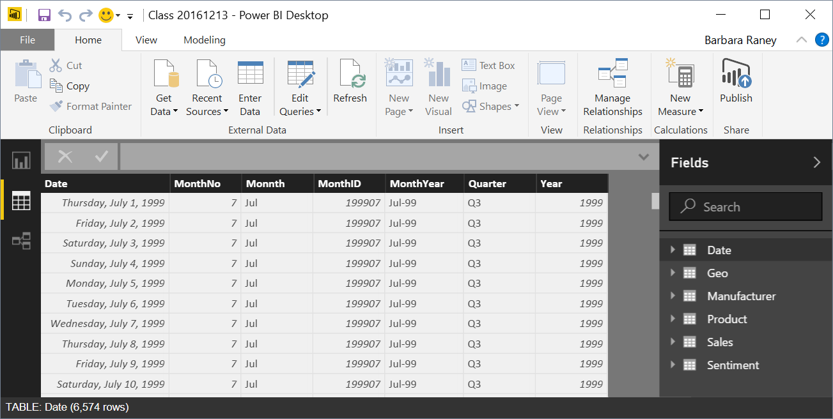
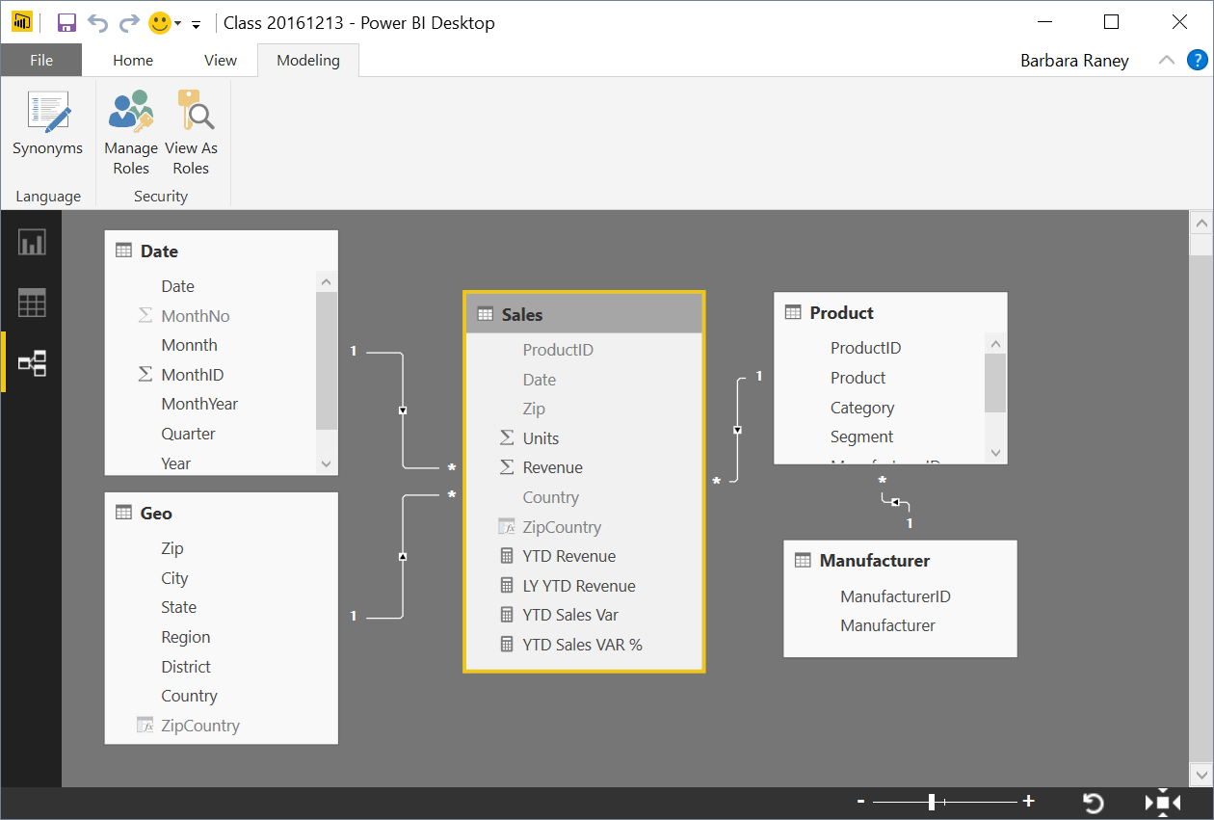
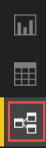

Power BI Desktop Data Flow
Data Sources
Power BI Desktop file (.PBIX)
Report
Create Visuals
Close & Apply
Close: Closes Query Editor
Apply: Loads data from sources to Data Model
Data (DAX)
View Tables
Query Editor (M)
Data Source Connections
Data Transformations
(Prep data for Data Model)
Relationships
See how Tables relate to each other
Notes:
This build slide emphasizes that the Query editor is for transformations and is a different window than the primary modeling views.

Slide 9
What is a Data model?
A Power BI Data Model is a collection of tables with relationships which enable your business users to easily understand and explore their data to get business insights.
Why is it important to have a Good Data model?
Improves understandability of the data
Increases performance of dependent processes and systems
Increases resilience to change
Notes:
In a good Data Model, the model can assume that column types are homogeneous (as they are strongly typed). This is different from Excel, where any given cell in a spreadsheet can contain different data types.

Slide 10
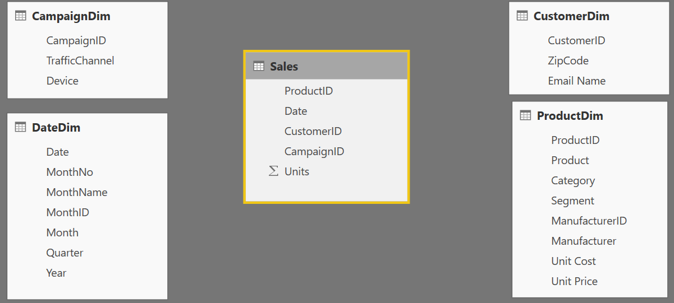
Components of a data model – Fact Table
Fact
Table
Fact Table
Contains Measures (or items to be aggregated) of a business process Examples:
Transactions
Sales Revenue
Units
Cost
Measures are usually sliceable.
Examples: By Month,
By Customer
Notes:
This slide builds automatically.
Depicts the data flow for Power BI Desktop along with what is in a PBIX file.
Note all the data sources that can be pulled into Query Editor.
Not the different views (Report, Data, Relationships) once all of the data is pulled in.

Slide 11
Components of a data model – Dim Table
Dim
Table
Dim
Tables
Dim
Table
Dim
Tables
Dim Table
A Dim (or Dimension) table contains descriptive attributes that define how a fact should roll up.
Examples:
By month, By Customer, By Geo
Notes:
The BY’s will be the dimensional attributes that we will use to describe the facts.

Slide 12

Components of a data model - Relationships
Relationships
Connection between a 2 tables (usually fact & Dim tables) using columns from each
3 kinds of Relationships
1 to Many
1 to 1
Many to Many
(with a bridge table)
Relationships
Relationships
Notes:
A Relationship is analogous to how an Excel VLOOKUP function brings two tables together
Can observe which side is the many (*) and which is the one (1) - CARDINALITY
When you draw the relationship, Desktop does several heuristic things
It checks that one side of the relationship is the “One” and the other is the “Many”
Directions of Relationship
Uni-directional are created by default and allows filters to get passed from attribute (dim) table to the Fact
Bi-Directional relationship allow you to pass filters in both directions
This is different than Many to Many
There is a significant performance penalty for Bi-Directional filtering

Slide 13
Data Model Brings Facts and Dimensions Together
Type of Data Models
Star Schema
Snowflake Schema
Flat or Denormalized
Note: This is not an exhaustive list, but are the most common model types used by Power BI.

Slide 14
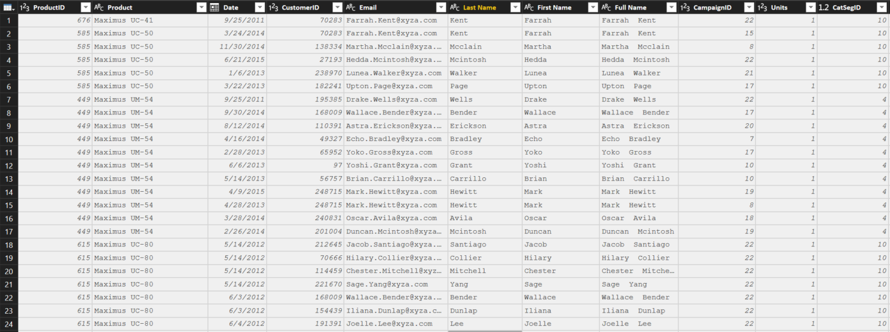
Flat or Denormalized Schema
All attributes for model exist in a single table
Highly inefficient
Model has extra copies of data > slow performance
Size of a flat table can blow up really quickly as data model becomes complex
Notes:
Similar to Excel with many V-Lookups
Denormalized are flattened versions where all attributes are copied into the same table
This is a requirement of a certain “T” competitor – and a major differentiator in the market

Slide 15
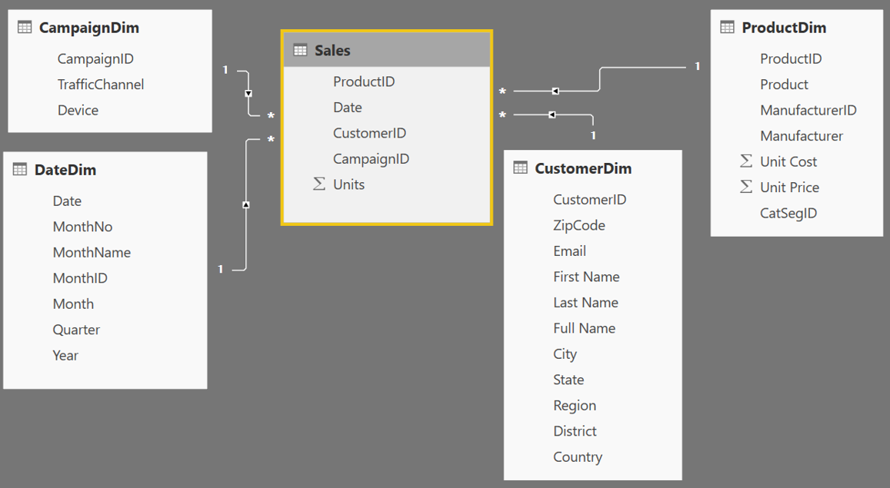
Star Schema
Fact table in the middle
Surrounded by Dims
Looks like a ‘Star’
Fact table is the “Many” side of the (one to many) relationship
1
1
1
Many
1
1
Many
Notes:
By extracting the repeated attributes to dimension tables, you are lowering the amount of memory required by the data model.

Slide 16
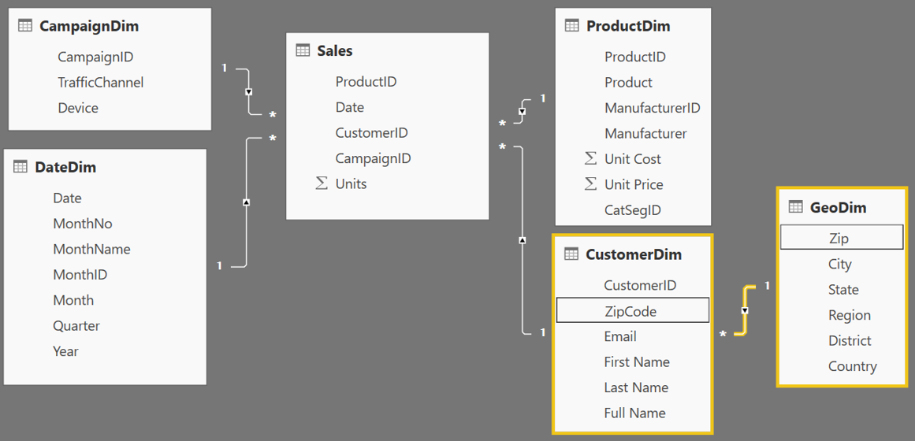
Snowflake Schema
Center is a Star schema
Fact table in middle
Surrounded by Dims
Dims “snowflake” off of other Dims
If you have many, it looks like a ‘Snowflake’
Dim or Fact tables can be the “Many” side of the relationship
Dims
Facts
Dims
Flake
Snowflake
Notes:
“Snowflaking” off tables can be very beneficial when your dimensions have several repeating attributes that can be extracted to their own table.
A zip code is associated with multiple attributes
Talk about your own zip code and the richness associated with that particular zip

Slide 17
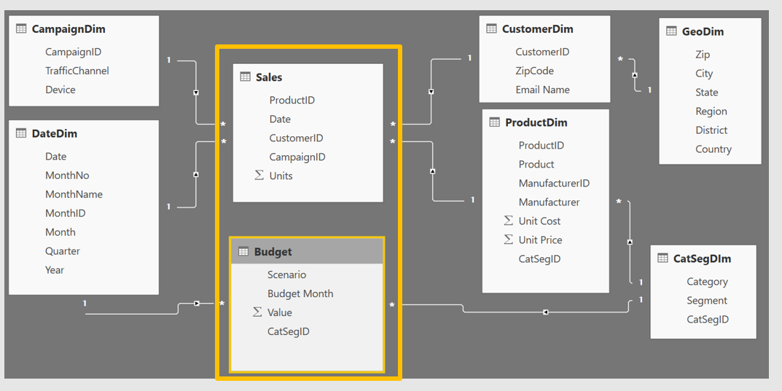
Granularity & Multiple Fact Tables
Grain (granularity) measures the level of detail in a table
Example:
One row per order or per Item
Daily or Monthly date grain
If your facts have very different granularities, split them into Multiple Fact tables & connect them to shared dimensions at the lowest common granularity.
Sales (Daily by Product)
Budget (Monthly by Product Category & Product Segment)
Notes:
Keep in mind, your measures (calculations) should be placed on a fact table, but it really does not matter which one. The key is that measures should not be placed on dimension tables.
When you have a fact at the Month grain, like budget, you can create a calculated column which holds the first (or last) day of the month to use in creating the relationship.

Slide 18
New(ish) Features
Notes:
Demo the new ability to mass-edit columns in the model screen
Demo the new model breakout screen
Demo the display folder functionality
Demo the idea of a Measure table

Slide 19



How can I tell what Data Model Type I have?
Data Mode Types in Power BI
Live Connect to SQL Analysis Services (SSAS) tabular
Report view only available
DirectQuery to SQL or other relational source
Report & Relationship views available
Import data into Power BI (creates a copy of the data)
Report, Data and Relationship views available
Notes:
Quick note with 2 pictures Black Nav bar that shows a live connect doesn’t have the relationship or the data tab
Direct Query doesn’t have the Relationship button

Slide 20
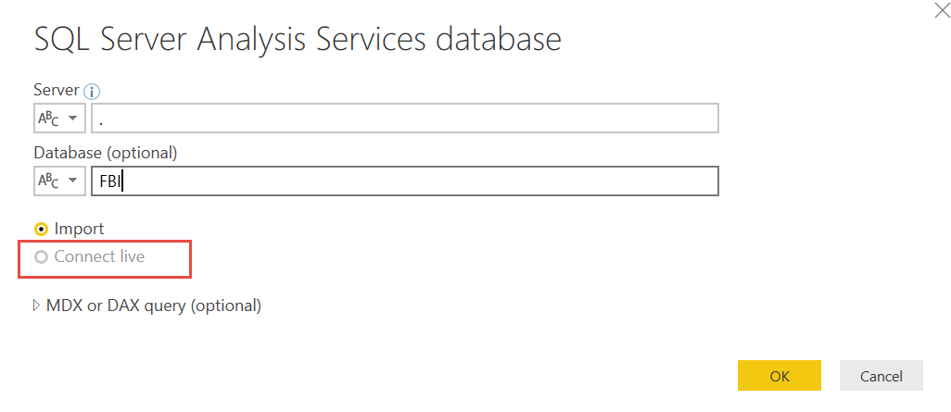
Connection: Live Connect
Live Connect to Multidimensional or Tabular
On Premise or Azure
Only a single connection will be made and all modeling is done in the cube
You can not add relationships or additional data source
If allowed, you can add DAX measures

Slide 21
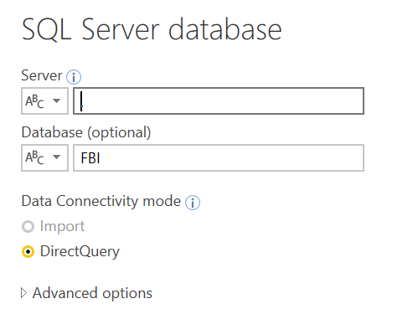
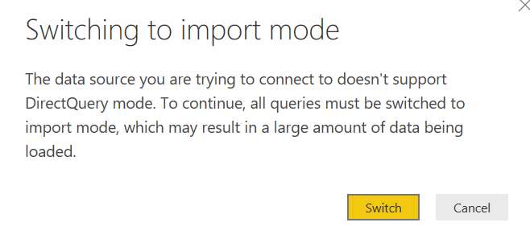
Connection: DirectQuery to Relational Source
Direct Query to SQL or other relational source
On Premise or Azure
All Data Sources are required to be DirectQuery, you cannot “Mashup” with Import sources or you get this message
You can add relationships and DAX
Notes:
Combining DirectQuery and import in a single Power BI dataset is not supported at this time.
It’s worth mentioning that the product team recommends DQ mode only in situations where low latency is the driving factor. If you have a situation where import is resulting in too large of a dataset, you should consider optimizing the data you are pulling in to better take advantage of the tabular model’s in-memory columnar datastore that’s running in Power BI’s back end.
A few things to consider:
Removing fields—best practice is that if it isn’t a field you’re reporting on, think very carefully about whether it needs to be included in the model
Reducing the number of text fields with many unique values—see this whitepaper (https://msdn.microsoft.com/en-us/library/dn393915.aspx) for more information on how tabular models compress data and what you can do to identify the worst offending fields and optimize compression or performance
Reducing the date range of data being brought in—it is common to see business users want to bring in all historical data—it’s worth asking whether their business has fundamentally changed in the last X years where trends from before X years are not relevant

Slide 22
What is unique about Power BI Desktop in Import Mode?
Import Mode
Columnar database
In-memory database

Slide 23
Columnar Database
Row Based Database
PBI - Columnar Database
First Name | Last Name | Sales
John | Smith | $10
Jane | Doe | $25
Hardy | B | $35
First Name | Last Name | Sales
John | Smith | $10
Jane | Doe | $25
Hardy | B | $35
Stores each row separately (like a separate file)
Retrieving multiple columns from a single row is fast
Retrieving multiple rows from a single column is slower
Stores each column separately (like a separate file)
Retrieving multiple columns from a single row is slow
Retrieving multiple rows from a single column is faster
Columnar databases are well suited for analytics
Notes:
No Additional Notes.

Slide 24
In-Memory Database
PBI – In-Memory Database
Data stored in RAM (in memory)
RAM is all electronic – Read/Write is fast
Laptops have smaller RAM space (~8GB)
Power BI compresses data to conserve space in RAM
Notes:
Every Row is stored in a separate “File”
How many files do I open to get the “total Sales”?
For ANALYTICAL - To get the total sales – it will only need to open ONE File
* Column based architecture is better for Analysis

Slide 25
How Power BI Compresses Data – Dictionary Encoding
Compressing Data – Dictionary Encoding
Sale Id | Color | Sales Amount
390a30e0-dc37 | Red | $10
390a30e1-dc37 | Green | $25
390a30e2-dc37 | Red | $35
390a30e3-dc37 | Red | $15
390a30e4-dc37 | Red | $25
390a30e5-dc37 | Green | $30
390a30e6-dc37 | Blue | $10
390a30e7-dc37 | Blue | $12
390a30e8-dc37 | Blue | $15
390a57f0-dc37 | Blue | $18
390a57f1-dc37 | Green | $25
Red = 1 Green = 2 Blue = 3
Create a Dictionary to create an integer value for text string
Storing 1,2,3 instead of “Red”, “Green”, “Blue” saves memory
Dictionary encoding is powerful when there are few unique values in a column
Ex. Color column – Good for dictionary encoding
Ex. Sale ID – Bad for dictionary encoding
Notes:
We tend to be data “Hogs” - which columns do you really need?
In a proper Star Schema, Dictionary Encoding would primary affect Dimension table, or text fields on Fact table (of which there should be few, if any).

Slide 26
How Power BI Compresses Data – Run Length Encoding
Compressing Data – Run Length Encoding
Sale Id | Color | Sales Amount
390a30e0-dc37 | Red | $10
390a30e1-dc37 | Green | $25
390a30e2-dc37 | Red | $35
390a30e3-dc37 | Red | $15
390a30e4-dc37 | Red | $25
390a30e5-dc37 | Green | $30
390a30e6-dc37 | Blue | $10
390a30e7-dc37 | Blue | $12
390a30e8-dc37 | Blue | $15
390a57f0-dc37 | Blue | $18
390a57f1-dc37 | Green | $25
Run Length Encoding in Power BI
Instead of storing - 1, 2, 1, 1, 1, 2, 3, 3, 3, 3, 2
It Stores:
Run length encoding is very powerful when data is sorted well and has few unique values
1
2
1
1
1
2
3
3
3
3
2
Where Red = 1 Green = 2 Blue = 3
1 – 1 (1 instance of One)
1 – 2 (1 instance of Two)
3 – 1 (3 instances of One)
1 – 2 (1 instance of Two)
4 – 3 (4 instances of Three)
1 - 2 (1 instance of Two)
Notes:
Image compression technique which is used to compress black and white images. The PowerBI team is using this same Run Length compression.
If you have 10,00 TRUEs then 10,000 FALSEs, it will provide the best compression of the column
Memory compression and performance are directly related
Mention Kaspers’ calculation blog post to find out how your memory is used. (Link in Post)

Slide 27
Practical Example of Compression
Compression
Dashboard in a Day Class Data
DIAD Complete Data Model
Sales Fact | 420.0 MB
Dimensions | 4.4 MB
Int’l Sales | 32.4 MB
Total Data | 456.8 MB
Data Model | 59.4 MB
Almost 8X Compression!!
Queries ONLY – No Data Loaded
Query Metadata | 113 KB
Notes:
* When the file is closed – it is saved to the hard disc
When opened, the DB is stored in RAM (Approx 60% of machine’s available RAM)
Hard Disk has mechanical parts - read/writes are slower
In-Memory – read/writes are faster
RAM is precious, and the PowerBI team uses many techniques to compress data
In the Service, datasets are limited to 1 GB.

Slide 28
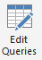

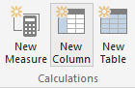
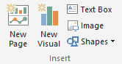
Phases in Building a Power BI Desktop File
Power BI Desktop Files
“Get Data” Phase
Model Creation Phase
Model
Enhancement
Phase
Visual
Building Phase
Create Query in “M”
Compress data, auto detect relationships
(Automatically done by Tool)
Add calculated columns, measures, add missing relationships
Evaluate Measures and build each visual
Notes:
Should be 1 hour into the training at this point
In Power BI desktop connect to Raw Data Excel file that contains all data for the Power BI model. Pull Sales Fact , Geo and Date
Show the Get data phase
Show how if you do apply later and save just the “Query information” is saved
If you apply data – Data transformation changes are saved (All data is loaded, and most relationships are created)
Add a relationship for the date column
Show how you can add a calculated column and measure
Calc Column on Product Dimension: Price Band = IF(ProductDim[UnitPrice]> 10, “High”, “Low”) – memory inefficient – less optionally compressed as is not sorted
Measures: Total Sales = Sum(SalesFact[Sales]) – no result yet – as a measure is ONLY calculated when a visual is built
Finally build a few visuals and show how the measures are evaluated during visual building phase – you can start with a simple matrix to check values
Process Time Vs. Query Time
Time to take to process the model (Process) includes all calc columns
Time to build a Visual (Query) includes measures

Slide 29
Key takeaways to design a good Power BI Desktop data model
Designing good data models
RAM is precious !!!!!
Some Tips and tricks to save RAM and increase speed of model
If a fact table contains an ID field which is unique for each record, remove it
Ex. Transaction ID
Sort columns before bringing them into a Power BI data model
The DateTime data type is usually not needed, unless you are specifically using the Time component
If you really need Time, try splitting Date & Time into two columns - Reduces # of unique values
Star Schema – Good for most Data Models
Notes:
* When the file is closed – it is saved to the hard disc
When opened, the DB is stored in RAM (Approx 60% of machine’s available RAM)
Hard Disk has mechanical parts - read/writes are slower
In-Memory – read/writes are faster
RAM is precious, and the PowerBI team uses many techniques to compress data
In the Service, datasets are limited to 1 GB.

Slide 30
Data Types
Numeric Data Types
Whole Number
Decimal Number
Fixed Decimal Number (Floating point stored as integer)
Boolean
Date/Time Data Types
Date – Internally stored as an integer
Time – Internally stored as a fraction between 0 and 1
Date Time
Other Data Types
Text
Any – You should never see this in a data model. Bad things can happen!!
Set your Data Types in the Query Editor
Set your Data Formats ($ %, etc) in the Data Model
Pro Tip: Data type is different from data format
Notes:
Data Types are how data is stored, as opposed to Data Formats which are how data are displayed
Discuss the difference between Fixed Decimal (Currency) and Decimal (which has floating decimal)
Fixed Decimal is 19.4 – 19 places to left of decimal and 4 to the right, which allows for proper processing of pennies. Best for Currency numbers.
Decimal can be less efficient when the data has excessive precision
Discuss splitting DateTime into Date and Time columns so that they compress better
Fixed Decimal numbers – stored like whole number uses less memory than Decimal

Slide 31
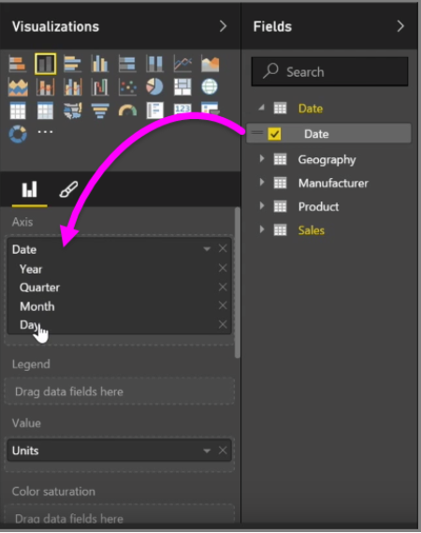
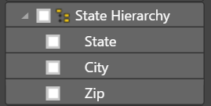
Hierarchies
Power BI generates Date hierarchies when dates are added to visuals, this allows the end user to drill from Year, Quarter, Month & Day.
Users can also create custom hierarchies in the model by dragging a lower level field onto the parent.
Notes:
Can approximate hierarchies in the drill path of a visual

Slide 32
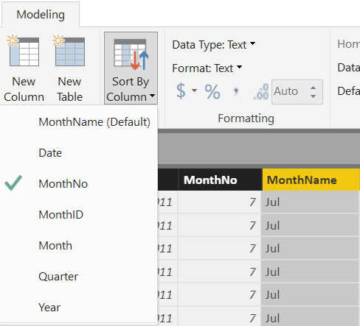
Sort By Column
Enables sorting one text field by another (numeric) field
Both columns must have the same number of distinct values
Notes:
Sort by Column was shown in DIAD, but it is important modeling concept to know.
This is applied in the Data section of the model.

Slide 33
Module 1 Lab
Open up the file Pre-class.pbix
Create the relationships between the tables!
HINT: You may need to preview some of the tables to see what is in them
Think about: What sort of data model are you creating?
Notes:
The final relationship diagram can be viewed in the Instructor Complete Modeling.pbix file.

Slide 34
KNOWLEDGE CHECK Module 1
What is a data model in the context of Power BI?
What are some advantages of a star schema over a flat or denormalized model?
How might you improve the performance of a Power BI model?
How does Power BI store DateTime information? What are some consequences of this?

Slide 35
Module 2
DAX Calculated Columns & Measures

Slide 36
MODULE 2 OBJECTIVE
Understand differences between calculated columns and measures (uses, evaluation, performance, etc.)

Slide 37
DAX Level Set
DAX looks similar to Excel functions but they have key differences
DAX is a very deep and elegant…
This class provides a solid base in DAX, but don’t expect to leave being able to write the most complex DAX patterns--they take practice.
Notes:
Let’s be real.
- DAX is easy to get started with (due to similarity to Excel)
- DAX mastery takes a lot of time to acquire
- Subtle differences in DAX formulas can have profound results!

Slide 38
Path to DAX Expertise
DAX Foundations
Evaluation Contexts
CALCULATE
Calculated Columns and Measures
Notes:
Even though this class is 200 this is really a 100 level DAX class
DAX answers are not “one size fits all” – we are trying to help you find some hidden gems

Slide 39
DAX Foundations
Calculated Column
Measure
Notes:
Calculated Columns and Measures are both written in the DAX Language.
A Calculated Column is evaluated as a new column in the table in which it resides and will not change value until the underlying data is refreshed.
Measures are calculations which do not have a result until they are used in a visualization. They may use sums, averages, minimum or maximum values, counts, or more advanced calculations; and they change value in response to your interaction with your reports.

Slide 40
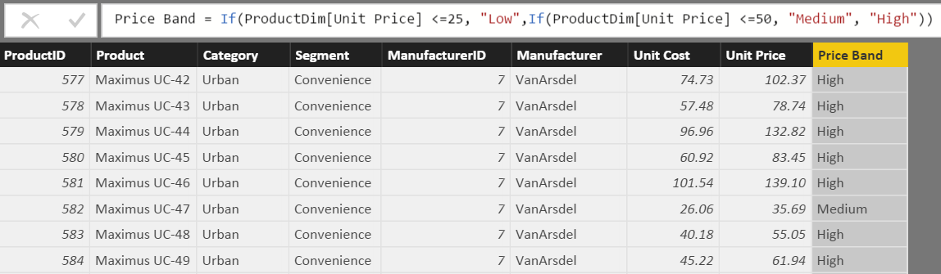
What is a Calculated Column?
Price Band = IF{ProductDim[Unit Price] <=25, “Low”, IF(ProductDim[UnitPrice] <=50 “Medium”, “High”))
Calculated Column
Pro Tip: Always refer to a calculated column by its full name -> TableName[ColumnName]
Notes:
Used to add attributes that don’t exist in the source data
See this formula. This looks a lot like Excel
Demo:
In Product Dim Table add the above formula from the Tab called “Calculated Column”

Slide 41
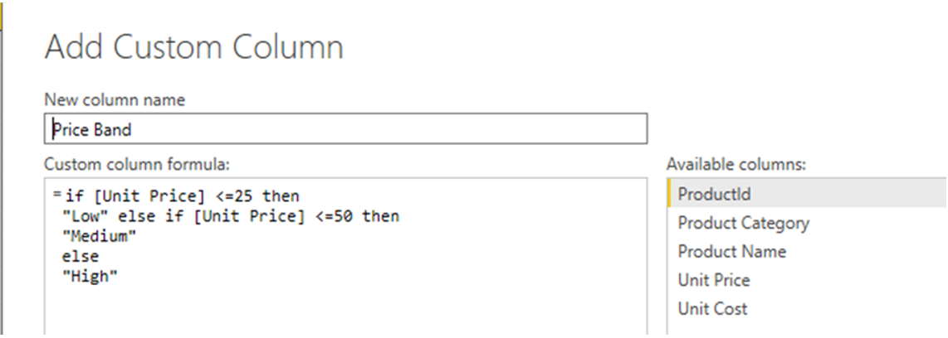
Calculated Column in DAX
Calculated Column
Custom Column in “Query Editor”
Note: If given a choice, creating the column in “M” or “Query Editor” will give you better compression.
Notes:
DEMO: If a question comes up related to how to create a calculated column in ”M”, then do the following:
Open Query editor and create a calculated column using this formula:
if [Unit Price] <= 25 then "Low" else if [Unit Price] <=50 then "Medium" else "High“ M is case sensitive and the if/then/else syntax is different than Excel/DAX
Instructor Talking Point, if needed:
Once the column comes in it becomes like any other column in Power BI Desktop file
The column is compressed
There is a secondary processing for Calculated Columns – Which makes process times slower

Slide 42
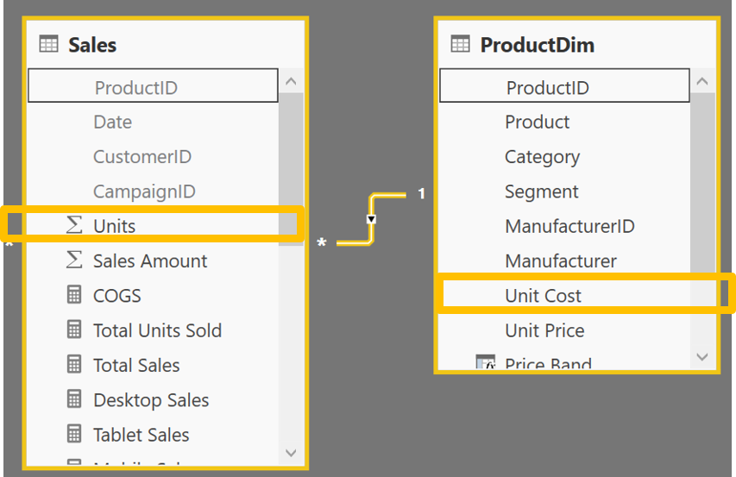
Calculated Column – Accessing columns from other Tables in model
Calculated Column
Often you want to access columns from multiple tables to create a Calculated Columns
Let us say you want to calculate COGs, which is Units * Units Cost
Units Cost is in another Table

Slide 43
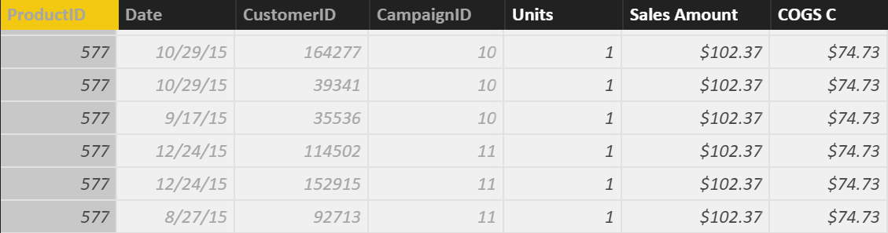
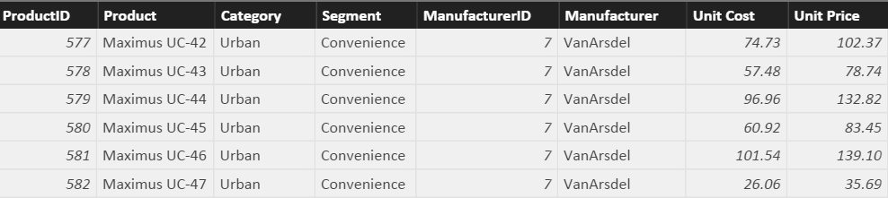
Row Context and Multiple Tables – RELATED Function
RELATED Function
Sales COGS = RELATED(ProductDim[Unit Cost]) * Sales[Units]
Sales Amount = RELATED(ProductDim[Unit Price]) * Sales[Units]
RELATED is just like VLOOKUP in Excel
Notes:
First Bring in the column. Let it resolve and then multiply
Demo:
In SalesFact Table write this formula: Sales[COGS] = RELATED(ProductDim[Unit Cost]) * Sales[Units]
(also available in Calculated Column Tab)
Note to instructor: Just like Vlookup but without all of the drama – No NA()

Slide 44
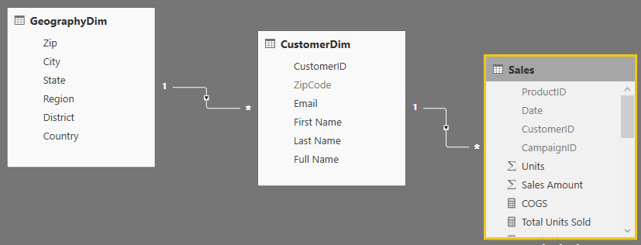
RELATED Function Example
RELATED Function
You could follow a chain of relationship from Many side to 1 side using RELATED
Sales City State= RELATED(GeoDim[City]) & “, ” & RELATED(GeoDim[State])
Notes:
This is an example of “Just because you can, does not mean you should”
Creating a calculated column like this on the fact table takes way too much memory when it could just as easily be placed on the GeographyDim table.
No Demo on this slide
Note to Instructor: If you need to aggregate back from 1 side to the Many side, there is a companion formula called RelatedTable – but we will cover that later.

Slide 45
When is a Calculated Column Evaluated?
DAX Foundations
“Get Data” Phase
Model Creation Phase
Model
Enhancement
Phase
Visual
Building Phase
Create Query in “M”
Compress data
Auto detect relationships
Add calc. columns, Measures
Add missing relationships
Evaluate Measures and build each visual
Notes:
Note to Instructor: This has already been covered and is just reinforcing a concept covered in a previous slide.

Slide 46
Best Practices with DAX Calculated Columns
Best Practices – Calculated Columns
Whenever possible, DAX helper columns should be avoided. Each “Helper Column” will consume RAM
Create a calculated column in the Dim Table as opposed to in the Fact Table
Move calculated columns to “M” if you can
Notes:
Instructor Talking Point,
Best Practice is to create a calculated column at the HIGHEST level of granularity - in the highest dim

Slide 47
DAX Foundations
Calculated Column
Measure
Notes:
Instructor Note: From the Definitive Guide to DAX (Russo, Marco and Ferrari, Alberto)
Calculated Column is just like any other column in a table and you can use it in rows, columns, filters, or values of a pivot table or any other report. You can use it to define a relationship, if needed. The DAX expression defined for a calculated column operates in the context of the current row of the table to which it belongs. Any reference to a column returns the value of that column for the current row. You cannot directly access te values of other rows. – Important concept is that a Calculated Column is computed during the processing and then stored into the model. The Calculated Columns occupy space in memory.
Measures are another way to define calculations but when you do not want to compute values for each row but, rather, you want to aggregate values from many rows in a table. A measure needs to be defined in a table but does not really belong to the table and can be moved from one to another without losing its functionality.
Differences between calculated columns and measures – even if they look similar, there is a big difference between these. The value of a Calculated Column is computed during data refresh and uses the current row as a context; it does not depend on user activity on the pivot table. A measure operates on aggregations of data defined by the current context. A measure always operates on aggregations of data under the evaluation context.

Slide 48
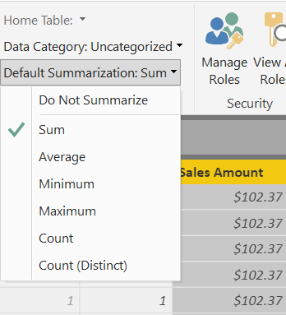
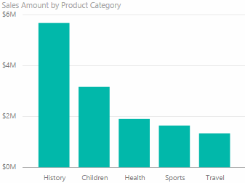
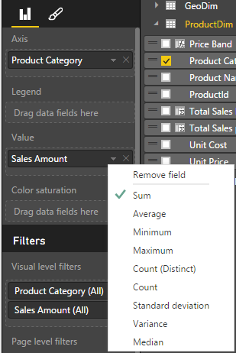
What is a Default Summarization?
Default Summarization
On the Modeling ribbon
For an individual visualization
Sales Amount is automatically summed for each category
You should set this summarization for all numeric fields in the Modeling ribbon
Notes:
For fields like Year, which are numeric, but you would prefer to not summarize, set the global Default Summarization on the Modeling Ribbon
DEMO: Show Default Summarization tab
Instructor Note:
Ask the participants why it works (ie. How does it know to Sum?).
When you drop a calculated column into the visual, Power BI creates Implicit Measure (using Default Summarization). In this case, the implicit measure is Sum of Calc COGS.
Bring in Sales Amount column from the Sales Fact Table into the value section of the graph on the top left hand side.
Instructor Note:
Creates Implicit Measure – Default Summarizations – we can change it.
Dropping a Text column into the Values – will create a count.
Revert this to a Sum on the sales amount at the end of the demo. We will be using the Sales Amount again and we want to make sure it is a Sum.

Slide 49
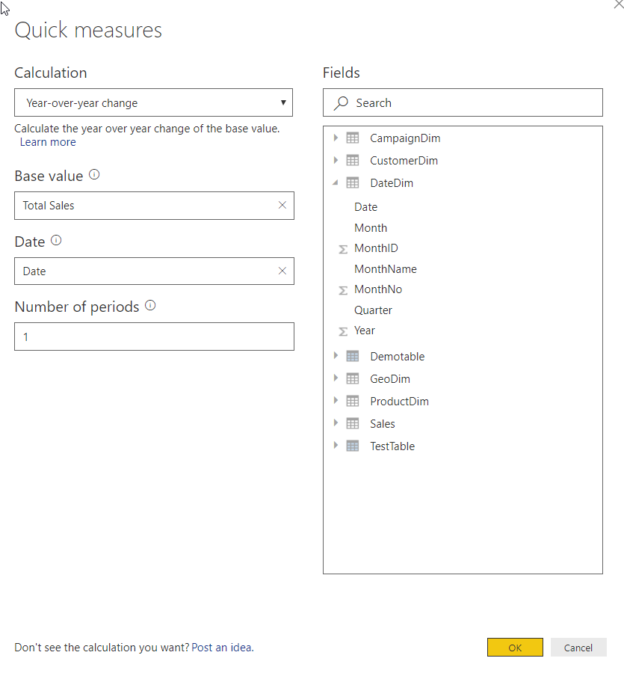
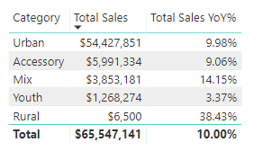
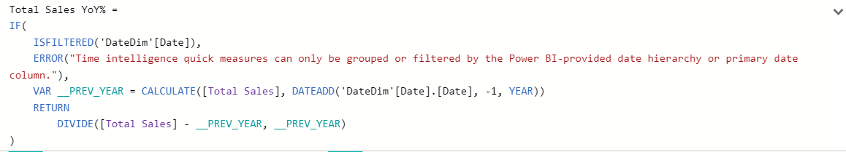
Quick Measures are wizard driven DAX calculations
Quick Measures
Right+Click a table and select Quick Measures
Select calculation type and fill-in parameters
DAX is generated automatically
Great way to learn DAX
See Quick Measure gallery: https://community.powerbi.com/t5/Quick-Measures-Gallery/bd-p/QuickMeasuresGallery
Notes:
DEMO: Create a Quick Measure in the data model
Note that the DAX has error handling, and my be more complex than the user would write themselves.

Slide 50
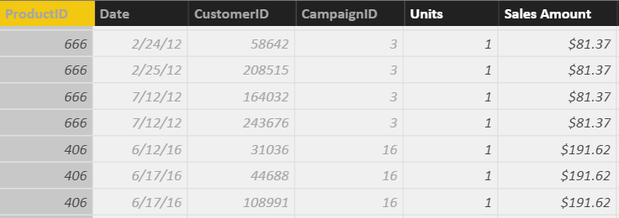
What is a Measure?
Measures
Total Sales=SUM(Sales[Sales Amount])
Total COGS=SUM(Sales[Sales COGS])
Measures are created using DAX
Place your Measures on a Fact table for best results
Pro Tip: When referring to a measure in other calculations, refer to it without a Table name: [MeasureName]
Notes:
DEMO:
From the Modeling Ribbon, show measure called Total Sales and that resolves to the same values as default summarization.
Formula: Total Sales = SUM(Sales[Sales Amount])
In the Measure tab, drop the Total Sales measure onto the graph on the right in the values section
Instructor Talking Points:
Explain the calculations in DAX vs Power BI:
On the graph on the top left, the calculations are done by Power BI implicitly.
The graph on the right, show the calculations on the right in DAX which are written, explicitly.
Instructor Note:
Talk about Home Tables. Even though it looks like Measures are in a Fact Table internally they are stored in a separate table called Measures Table
Always ensure the Home Table is a FACT table
Be sure the mention that measures should only be associated with FACT tables, and that measure names must be globally unique within the data model.
If class is interested, may be worth mentioning that the reason measure names must be unique is that they end up being associated with a hidden measures-only table that gets created in the data model

Slide 51
Measure, Use Case 1: Using One Measure in Another
Measures
Instead of writing this:
Profit = SUM(Sales[Sales Amount])-SUM(Sales COGS)
Write this:
Profit = [Total Sales]- [Total COGS]
Allows re-use of measures
Formulas are much simpler to read
Notes:
Advantage to writing DAX
Simplify DAX by referencing other Measures
Quickly reference the list of measures from the formula bar by typing “[“ – As all Measures start with this character

Slide 52
Measure, Use Case 2: More Complex Calculations
Measures
Profit Margin % = [Profit] / [Total Sales]
Ratios are calculations that cannot be created using a Calculated Column or Default Summarization
Use DAX DIVIDE for built in error handling
Profit Margin % = DIVIDE([Profit] , [Total Sales])
Notes:
DEMO:
Profit Margin = Sales[Sales Amount] – Sales[Cogs]
Profit Margin % = DIVIDE([Profit Margin], Sum(Sales[COGS]) )

Slide 53
When is a Measure Evaluated?
DAX Foundations
“Get Data” Phase
Model Creation Phase
Model
Enhancement
Phase
Visual
Building Phase
Create Query in “M”
Compress data
auto detect relationships
Add calc. columns, Measures
Add missing relationships
Evaluate Measures and build each visual

Slide 54
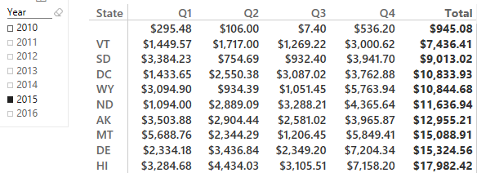
Calculated Column vs. Measure - When to Use What
Calculated Column vs. Measure
Columns
Values
Slicer
Rows
Rule of Thumb for Calculated Column vs Measure
Calculated Column – Use in Page, Report & Visual Filters as well as Slicers, Rows and Columns
Measures - Use in Values section
Notes:
Values use either an implicit Measure or Explicit Measure (explicitly written DAX)

Slide 55
Module 2 Lab
Create a MEASURE for Total Units
HINT: The formula will probably use SUM()
Create a CALCULATED COLUMN on the fact table that shows product category and campaign traffic channel combined
Example: Urban, Organic Search
It is fairly easy to see that the CALCULATED COLUMN is working. Create some visuals that allow you to confirm that the Total Units Sold MEASURE is working right
Notes:
Just because you can doesn’t mean you should add a calculated column to the fact table.
Insure the instructors know to create a table with the new field and measure, then show that you can create the same visual by dragging the two "related" fields into the a table with the units. Same visual, no expensive calculated column
Expected results:
1. Total Units = SUM(Sales[Units])
2. Category, Campaign = RELATED(ProductDim[Category]) & ", " & RELATED(CampaignDim[TrafficChannel])
3. Create a table (or column chart, or whatever) and compare the explicit measure that was just created with the implicit measure from pulling in Units. Talk about how you might go about verifying a more complex measure.

Slide 56
KNOWLEDGE CHECK Module 2
When is Calculated Column Evaluated?
What is Default Summarization?
When is a Measure Evaluated?
When to use Measures and Calculated Columns?
Notes:
What happens when you drop a Calculated column in a Values section – DAX implicitly calculates a measure on top of it. It is a bad thing because you did not tell DAX what to do and DAX just assumed that you wanted to do something with it.
Ex. Drop Profit in Sales

Slide 57
Module 3
CALCULATE

Slide 58
MODULE 3 OBJECTIVE
Understand the basics of the CALCULATE formula

Slide 59
PATH to DAX Expertise
DAX Foundations
Evaluation Contexts
CALCULATE
Calculated Columns and Measures
Notes:
Evaluation Context – Single biggest reason that people give up on DAX
Want to Simplify the Evaluation Context

Slide 60
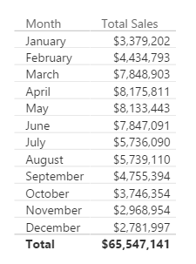
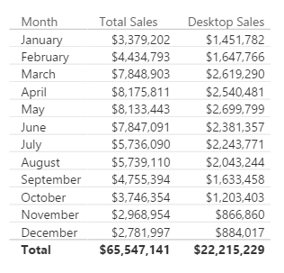
Why is CALCULATE Useful?
CALCULATE
You create a report of breakdown of Sales by Month
Typical Business Question:
Provide a break out of this Sales from Desktop
Notes:
In Excel, there are SUMIF and SUMIFS functions – Calculate give you that flexibility and much more as it can be used with ANY Aggregation/Calculation
MYR – Drill to one Department’s data – and change the shape and it will all still work

Slide 61
Here is how you do it with CALCULATE
CALCULATE
Desktop Sales = CALCULATE([Total Sales], CampaignDim[Device] = "Desktop")
Use CALCULATE function to create a Measure which filters down to Desktop Sales
Notes:
Note that even if you apply a “Device” Slicer to this page, the measure [Desktop Sales] will always show Desktop

Slide 62
Anatomy of CALCULATE
CALCULATE
CALCULATE(Expression, [Filter 1], [Filter 2]…a..)
Filter Arguments
EXPRESSION used as the first parameter is essentially the same as a measure
CALCULATE works differently from other DAX functions
The second set of arguments, i.e. the “Filter arguments,” are evaluated and applied first
Then the Expression is evaluated under new “Filter Context"
Notes:
ALL Filters arguments are ANDs – FILTERS ARE CALCULATED FIRST (to filter the rows), then the math is applied

Slide 63
CALCULATE – The Most Important Function in DAX
CALCULATE – Add Filter
4 Key functions that CALCULATE can do:
Add Filter
Ignore Filter
Update Filter
Convert Row Context to Filter Context
Notes:
Transition slide

Slide 64
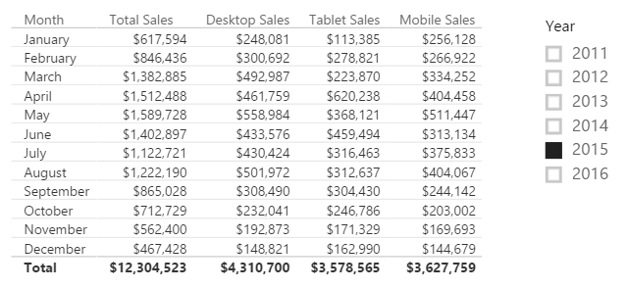
CALCULATE – Add Filter
Desktop Sales = CALCULATE([Total Sales], CampaignDim[Device] = "Desktop")
Tablet Sales = CALCULATE([Total Sales], CampaignDim[Device] = “Tablet")
Mobile Sales = CALCULATE([Total Sales], CampaignDim[Device] = “Mobile")
*When the Device Slicer is selected, only “Total Sales” changes.
Notes:
Demo: Table from “Calculate-Add” report
Note the effect that the Year Slicer has on the table (All items change)
When the Device Slicer is selected, only “Total Sales” changes.
Filter Context : Jan + 2015
Jan + 2015 + Desktop
Jan + 2015 + Tablet

Slide 65
CALCULATE – The Most Important Function in DAX
CALCULATE – Ignore Filter
4 Key functions that CALCULATE can do
Add Filter
Ignore Filter
Update Filter
Convert Row Context to Filter Context

Slide 66
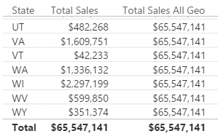
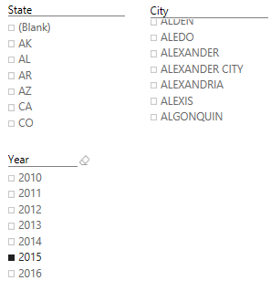
CALCULATE – Ignore an Existing Filter
Total Sales All Geo = CALCULATE([Total Sales], ALL(GeoDim))
City Only = LEFT(GeoDim[City],FIND(",",GeoDim[City])-1)
*Ignore filter on ANY column from the GeographyDim table, but allows filters from Year
Notes:
Optionally you can talk about the next three slides and then go into a demo to show all 3 in action instead of demoing each individually.
DEMO “Calculate- Ignore” Tab:
The table visualization, with each slide, expose the related column
Expose measure called [Total Sales All Geo] – Ignore filter on ANY column from the GeographyDim table, but allows filters from Year
Discuss that this measure can be used to calculate a % of Total measure

Slide 67
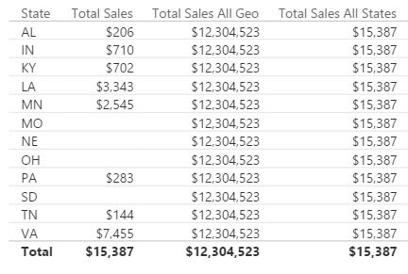
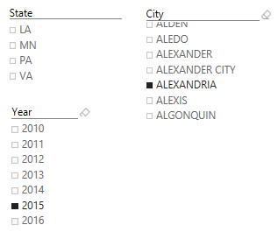
CALCULATE – Ignore an Existing Filter
Total Sales All States = CALCULATE([Total Sales], ALL(GeoDim[State]))
*Ignore filter on the STATE column from the GeographyDim table, but allows filters from Year
Notes:
DEMO “Calculate- Ignore” Tab:
The table visualization, with each slide, expose the related column
Expose measure called [Total Sales All State] – Ignore filter on the STATE column from the GeographyDim table, but allows filters from Year
Slice on City (Aberdeen is good)

Slide 68
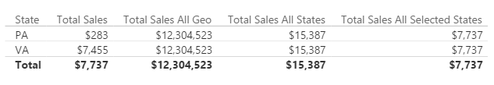
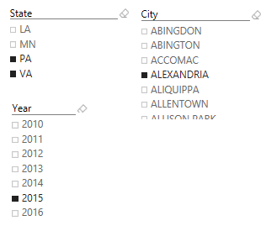
CALCULATE – Ignore Existing Filter
Total Sales All Selected States = CALCULATE([Total Sales], ALLSELECTED(GeoDim[State]))
*Ignore filter on the STATE column from the GeographyDim table, but allows filters from Year
Notes:
DEMO “Calculate- Ignore” Tab:
The table visualization, with each slide, expose the related column
Expose measure called [Total Sales All Selected State] – Ignore filter on the STATE column from the GeographyDim table, but allows filters from Year
Slice on City (Aberdeen is good), then select multiple State, see that the measure now only displays the total for selected states.

Slide 69
CALCULATE – The Most Important Function in DAX
CALCULATE – Update Filter
4 Key functions that CALCULATE can do
Add Filter
Ignore Filter
Update Filter
Convert Row Context to Filter Context

Slide 70
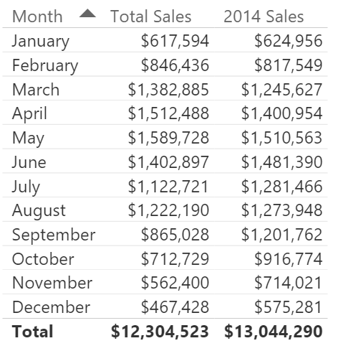
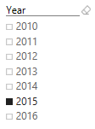
CALCULATE – Update Existing Filter
2014 Sales = CALCULATE([Total Sales], DateDim[Year] = 2014)
*Ignores filter on the Year Slicer
Notes:
DEMO “Calculate- Update” Tab:
The measure called [2014 Sales] – Ignores filter on the Year Slicer.

Slide 71
CALCULATE – The Most Important Function in DAX
CALCULATE – Convert Row Context to Filter Context
4 Key functions that CALCULATE can do
Add Filter
Ignore Filter
Update Filter
Convert Row Context to Filter Context
Let’s investigate what we mean by Filter Context
Notes:
Transition to Evaluation Contexts: Row & Filter

Slide 72
SHOUT OUT
ValoremReply.com
https://valoremreply.com/authors/joseph-hobbs/
KC Power BI User Group

Slide 73
Module 4 DAX Evaluation Contexts

Slide 74
MODULE 4 OBJECTIVES
Understand that there are different kinds of evaluation contexts and be able to explain what different contexts are in play
Be able to use iterator functions and CALCULATE to create sophisticated measures

Slide 75
PATH to DAX Expertise
DAX Foundations
Evaluation Contexts
CALCULATE
Calculated Columns and Measures

Slide 76
Evaluation Context
There are two contexts under which calculations are evaluated
Row Context
Filter Context
Notes:
Two gods you can invoke in your DAX calculation
Can be blended in a single calculations

Slide 77
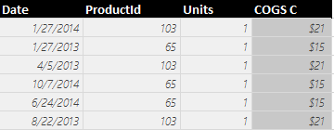
Row context in Calculated Column
Sales COGS = RELATED(ProductDim[Unit Cost]) * Sales[Units]
Formula is evaluated row by row
The context under which formula is evaluated for each row is called “Row Context”
Pro Tip: To accumulate up from Fact to Dimension, use RELATEDTABLE()
Notes:
Row context invoked when you refer to a column in a calculated column formula without an aggregation function surrounding it
Row Context – How many units sold in Row 1?

Slide 78
Evaluation Context
Both Calculated Columns and Measures are always evaluated under two contexts
Row Context
Filter Context
Notes:
Filter Context is defined by the Visual

Slide 79
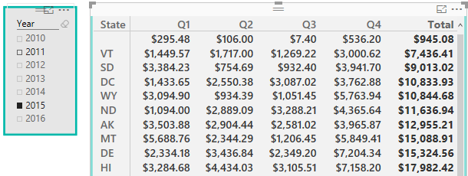
Filter Context in Measures
Filter Context in a Measure – Example 1
Total Sales = SUM(Sales[Sales Amount])
Filter Context for current coordinate
Year = 2015,
State = HI,
Quarter = Q1
Formula is evaluated for each “Coordinate” in each visual
The context for each coordinate is called “Filter Context”
Notes:
Discuss the filter context for the selected cell
Think in terms of co-ordinates (lat/longitude)

Slide 80
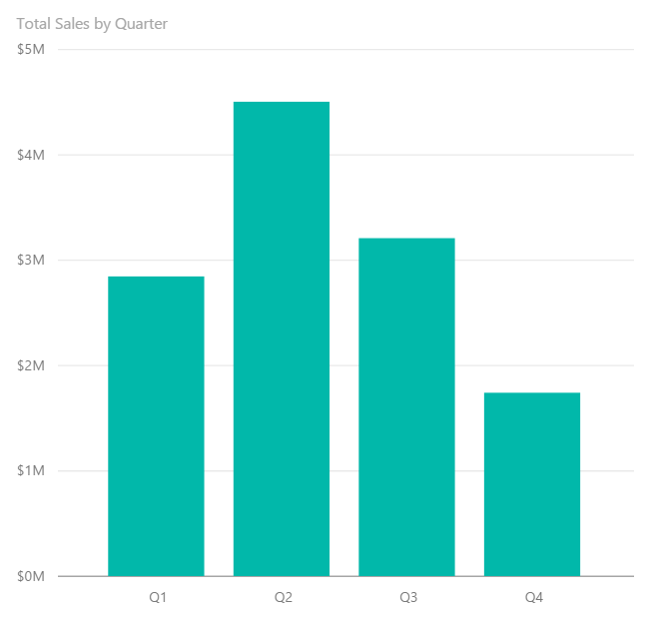
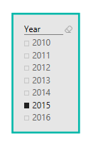
Filter Context in a Measure – Example 2
Filter Context in a Measure
Total Sales = SUM(Sales[Sales Amount])
Filter Context : Year = 2015, Quarter = Q1
Filter Context : Year = 2015, Quarter = Q2
Notes:
Charts and Graphs also have Filter Context. EACH data point has a unique Filter Context

Slide 81
Filter Context in a Measure
Filter Context in a Measure
[Total Sales] = SUM(Sales[Sales Amount])
Better definition of above measure:
“Total Sales” – SUM of Sales[Sales Amount] column under a filter context
Notes:
A measure is not evaluated until it is in a Visual – and will be under a filter context

Slide 82
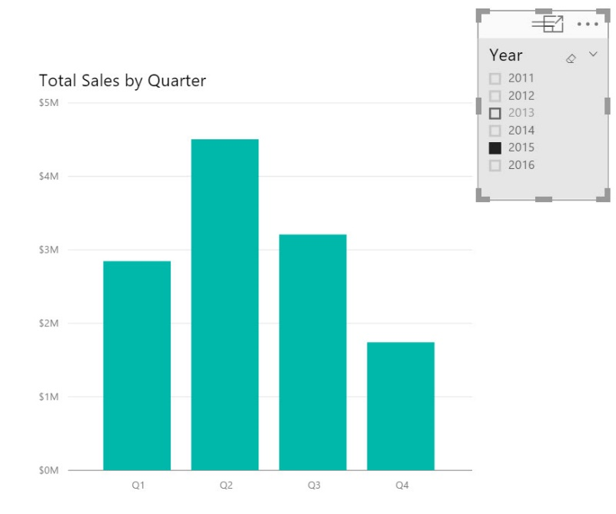

Filter Context and Multiple Tables
Filter context automatically propagates from Dim Table to Fact Table
Filtering the DateDim Table to Year = 2015 returns only Sales for 2015
Notes:
In a Uni-Directional relationship, the filter can only flow from the Dim to the Fact
In a BI-Directional relationship, the filter can flow each way.

Slide 83

Filter Context and Multiple Tables
Filter Context and Multiple Tables
Filters (Filter context) automatically propagate based on direction of arrows in relationships
Examples
Filter goes from DateDim to CustomerDim
Filter does not go from CustomerDim to DateDim
Notes:
In a Uni-Directional relationship, the filter can only flow from the Dim to the Fact
In a BI-Directional relationship, the filter can flow each way.

Slide 84

Filter Context and Multiple Tables – Right Arrow Direction
Filter Context and Multiple Tables
Cross filtering works properly
Arrow allows filters
Arrow allows filters
Filter goes from DateDim to CustomerDim
This is why the above Pivot table works
Notes:
Show going to the data model and updating the relationship from Single to Both (or back)
Toggle between this and the next slide
Why can’t I just enable all bi-directional relationships
They are expensive
Only turn them from Uni- to Bi- when absolutely necessary

Slide 85

Filter Context and Multiple Tables – Wrong Arrow Direction
Filter Context and Multiple Tables
Cross filtering does not work
Arrow allows filters
Arrow does not allow filters to flow to DateDim
Filter goes from DateDim to CustomerDim
This is why the Count of Month in the table above is incorrect
Notes:
See Barbara’ Blog on the many to many using key words (also note there is a custom Key Word text filter)

Slide 86
Evaluation Context Multiple Table – Summary and Take Aways
Evaluation Context and Multiple Tables
Row Context
Filter Context
Does not propagate automatically
Need to use
RELATED
RELATEDTABLE
Propagates automatically
Depends on direction of arrow in relationship diagram

Slide 87
DAX Function Types
Scalar Functions
Table Functions
Scalar functions return a Single value as an output
Ex. SUM(Sale[Sales Amount])
Table functions return a Table as an output
Ex. ALL(GeographyDim)
There are other ways to classify functions – By kind of operation they perform etc.
Notes:
Scalar is a fancy word for using a single coordinate in the evaluation
What if you want bring in a Table or List of values and apply your calculation to them?

Slide 88
Applications of Table functions
Table functions can be used 2 ways in Power BI Desktop
As an input to another DAX function
CALCULATE
Iterator functions
Calculated Tables
Notes:
Demo CALCULATED Table example in Power BI Desktop model
Call out the fact that CALCULATED Tables are just like a calculated column – Calculated during processing time or refresh time
You can use this table just like any other DAX in the model – You can create relationships etc.
Go to the Desktop and create a new Demo Table = ALL(GeographyDim) – duplicate with a separate memory footprint.

Slide 89
Basic TABLE functions
Return All Rows
Return Distinct Rows
Return Filtered Rows
ALL & variants
ALL, DISTINCT, VALUES
FILTER
There are more advanced Table functions, which we will not cover
Notes:
We will discuss three classes of Table function
No demo yet.

Slide 90
Basic Table functions – Return All Rows
The ALL function - Can take either Table or Columns in a Table as input
ALL with Entire Table
ALL with One Column
ALL with Multiple Columns
ALL(GeoDim)
ALL(GeoDim[Region]))
ALL(GeoDim[Region],
GeoDim[State])
Returns all rows all columns in Table
Returns all unique values of Column
Returns all unique combinations of Column values
Notes:
No Demo (already shown in previous demos)

Slide 91
Basic Table functions – ALL versions
There are several forms of the ALL function
ALL
ALLEXCEPT - Return all columns in a Table except 1 or more columns
ALLSELECTED – Return all values in a column selected by users in Slicers
ALLNONBLANKROW – Return all non-Blank rows
Notes:
We demonstrated these functions in the CALCULATE section
Table1 – has a duplicate row
When I write ALL on the whole table, I get the whole table
When I write ALL on the two columns of the table, it removes duplicates
Blank vs a mismatch
ALLEXCEPT - Overrides all context filters in the table except over the specified columns; useful when you want only one column on a table to be sliceable
ALLSELECTED – just like ALL, but if the column is specifically selected, then it respects the slicer
ALLNONBLANKROW – Just like ALL, but does not return any blank rows

Slide 92
Basic Table Functions – Return Distinct Rows
VALUES – Return all distinct values in a column or Table
(including blank rows)
DISTINCT - Return all distinct values in a column or Table
(not including blank rows)
Notes:
No Demo
If when you write VALUES and get a blank you may have Blank or MisMatch
If you change a VALUES to DISTINCT and you still have blank – then it is a real blank – NOT A MISMATCH
DISTINCT is more expensive as well
Blank vs a mismatch – If your model has Fact rows which do not match with dimensions, this is a mismatch – not a true blank.

Slide 93


Basic Table Functions – Return Filtered Set of Rows
FILTER(ALL(GeoDim[Region], GeoDim[State]), GeoDim[Region] = “Central”)
*this returns a table value, so it won’t work unless you wrap it in Calculate and add a measure
Add in Central Sales = CALCULATE ([Total Sales],
Take all unique combinations of GeographyDim[Region], GeographyDim[State]
Filter down to the rows where GeographyDim[Region] = “Central”
Notes:
The Region = “Central” is in a ROW Context as it is not surrounded by aggregate function

Slide 94
DAX Iterator Functions Take Advantage of Evaluation Context
DAX Iterator Functions
Iterator Functions
Creates a row context by iterating over a table that you specify
Ex. SUMX
Notes:
The table could be calculated ALL(DimGeography[State]) or a table in the data model DimGeography

Slide 95
Table Functions Application – Iterators
COGS = SUMX(Sales, Sales[Units] * RELATED(ProductDim[Unit Cost]))
Argument 1
Argument 2
Notes:
An iterator function takes two arguments – we will walk through this example over the next couple of slides

Slide 96

Table Functions Application – Iterators
COGS = SUMX(Sales, Sales[Units] * RELATED(ProductDim[Unit Cost]))
Argument 1
Iterate through each row in Argument 1
Sales
Notes:
Like a virtual calculated column, but don’t need to perpetually keep the column.
Argument 1 – iterate thru each of the columns in the table argument

Slide 97


Table Functions Application – Iterators
COGS = SUMX(Sales, Sales[Units] * RELATED(ProductDim[Unit Cost]))
Argument 2
Sales
ProductDim
Notes:
Perform the calculation for each row in the table argument

Slide 98

Row Context in a Measure – Iterator Functions
COGS = SUMX(Sales, Sales[Units] * RELATED(ProductDim[Unit Cost]))
SUM it up
SUM up list obtained
Notes:
Sum the results of all the rows.
Note: This calculation respects the Filter Context of the visual
This example is effectively SumProduct in Excel

Slide 99
Why Can an Iterator be a Better Approach then a Calculated Column?
Iterators
You avoid creating a Calculated Column
Let us see the impact of a Calculated Column Called COGS on Data model with 100K rows - What if we have 10 M rows?
Iterators help you avoid several “Intermediate Calculated Columns”
Notes:
DEMO: In your working copy of “Student Modeling Pre-class.pbix” where you have the calculated column [COGS] –
* Save the file and note the size for the class
* Remove the [COGS] calculated Column and re-save the file.
* Note that the file size is about 8% smaller. While file size is not an exact measure of memory use, it is a proxy that most students understand.

Slide 100
CALCULATE – Converting Row Context to Filter Context (Example 1)
DAX Foundations
Sales velocity Segment = IF(
SUMX(RELATEDTABLE(Sales), Sales[Sales Amount])>=200000,
“High Velocity”,
“Low Velocity”)
Sales Velocity (Using CALCULATE) = IF (
CALCULATE(SUM(Sales[Sales Amount])) >= 200000,
"High Velocity",
"Low Velocity")
Another way to do Dynamic Segmentation
This method does not use Iterators
Instead it uses CALCULATE to convert Row Context to Filter Context
Notes:
Walk through demo:
Go to ProductDimTable
Create a column = SUM(Sales[Sales Amount]) – This will show total sales for the entire data model not taking the row context into account.
Show the first Calculated Column, the SUMX and RELATEDTABLE functions transfer row context to filter context.
In the second formula wrapping the SUM in a CALCULATE does the same thing.

Slide 101
Other Iterator Functions
AVERAGEX , PRODUCTX, MINX, MAXX– All work the same way as SUMX
RANKX – Works similar to SUMX, but slightly more complex (more options)

Slide 102
Table Functions – Summary and Application
Table functions can be used in 2 ways in Power BI Desktop:
As an input to another DAX function
CALCULATE
Iterator functions
Calculated Tables
CALCULATE is one of the primary places where Table functions are used

Slide 103


Module 4 Lab
Create a report for the VP in charge of the Youth and Accessory Segments
Include a table visualization showing total units sold in the Youth Segment, Accessory Segment, and all other segments; by Campaign Device
Include a line chart showing total units sold in Youth and Accessory Segments by month
BONUS: Use Iterators on the Unit Cost and Unit Price from the ProductDim table to calculate Sales Amount, Cost of Goods Sold, Profit and build some visuals around them
Notes:
Expected results: users will need to create 3 measures to accomplish #1 and #2 :
- Youth Units Sold = CALCULATE([Total Units Sold],FILTER(ProductDim,ProductDim[Segment]="Youth"))
- Accessory Units Sold = CALCULATE([Total Units Sold],FILTER(ProductDim,ProductDim[Segment]="Accessory"))
- Rest of Company Units Sold = CALCULATE([Total Units Sold],FILTER(ALL(ProductDim),AND(ProductDim[Segment]<>"Accessory",ProductDim[Segment]<>"Youth")))
The visuals are a simple table and fairly straightforward line chart (be sure to use Date from DateDim)
For #3, users will need to create three measures :
Sales Amount M = SUMX(Sales, Sales[Units] * RELATED(ProductDim[Unit Price]))
COGS M = SUMX(Sales, Sales[Units] * RELATED(ProductDim[Unit Cost]))
Profit M = SUMX(Sales, Sales[Units] * (RELATED(ProductDim[Unit Price]) - RELATED(ProductDim[Unit Cost])))
alternatively, Profit M = [Sales Amount M] - [COGS M]
alternatively, users could accomplish this via calculated columns but this is not preferred.

Slide 104
KNOWLEDGE CHECK Module 4
What are the different kinds of evaluation contexts?
When are filter or a row contexts present?
Which functions are commonly used to modify existing evaluation contexts?

Slide 105
Module 5
Advanced DAX Time Intelligence Functions

Slide 106
MODULE OBJECTIVES
Be able to parse advanced DAX formulas (e.g., cumulative functions)
Gain familiarity with standard DAX patterns
Introduction to resources for further learning

Slide 107

Before we get to Time Intelligence - Let us apply all of the DAX techniques
Advanced DAX
SalesYTD =
CALCULATE (
[Total Sales],
FILTER (
ALL ( DateDim),
DateDim[Year] = MAX ( DateDim[Year] )
&& DateDim[Date] <= MAX(DateDim[Date])
)
)
Let us take a super complicated DAX statement and break it down and understand what it means
Notes:
Tab: Time Intelligence-YTD
Slides walk thru the logic – Follow the narrative of the next 5 slides

Slide 108
Before we get to Time Intelligence - Let us apply all of the DAX techniques
Advanced DAX
SalesYTD =
CALCULATE (
[Total Sales],
FILTER (
ALL ( DateDim),
DateDim[Year] = MAX ( DateDim[Year] )
&& DateDim[Date] <= MAX( DateDim[Date] )
)
)
In a CALCULATE statement Filter arguments are evaluated first
The Filter in this case comes from a FILTER function
FILTER function is an iterator

Slide 109
Let us apply all of the data modeling techniques
Advanced DAX
SalesYTD =
CALCULATE (
[Total Sales],
FILTER (
ALL ( DateDim),
DateDim[Year] = MAX ( DateDim[Year] )
&& DateDim[Date] <= MAX( DateDim[Date] )
)
)
In a FILTER statement the input Table is evaluated first
ALL statement means take all DateDim

Slide 110
Let us apply all of the data modeling techniques
Advanced DAX
SalesYTD =
CALCULATE (
[Total Sales],
FILTER (
ALL ( DateDim),
DateDim[Year] = MAX ( DateDim[Year] )
&& DateDim[Date] <= MAX(DateDim[Date] )
)
)
Iterate through each row in DateDim
Check for condition based on row context and filter context
Pro Tip: if you need to concatenate two conditions with an AND use && for and OR use ||

Slide 111
Let us apply all of data modeling techniques
Advanced DAX
SalesYTD =
CALCULATE (
[Total Sales],
FILTER (
ALL ( DateDim),
DateDim[Year] = MAX ( DateDim[Year] )
&& DateDim[Date] <= MAX(DateDim[Date] )
)
)
Now you have a FILTERED list of dates
Use this to update the filter context (since it is in a CALCULATE statement)

Slide 112
Let us apply all of the data modeling techniques
Advanced DAX
SalesYTD =
CALCULATE (
[Total Sales],
FILTER (
ALL ( DateDim),
DateDim[Year] = MAX ( DateDim[Year] )
&& DateDim[Date] <= MAX(DateDim[Date] )
)
)
Use updated FILTER context to evaluate ‘Total Sales’

Slide 113
Introducing Time Intelligence – There is an App for that!!
Advanced DAX – Time Intelligence
SalesYTD Easier =
CALCULATE (
[Total Sales],
DATESYTD(DateDim[Date])
)
This allows you to write the formula without being a DAX guru!
Microsoft is continuously improving Time Intelligence functions to make it simple to use
Time Intelligence functions are your friends – They will save you time!

Slide 114
Advanced DAX – Month over Month
Total Sales Last Month =
CALCULATE([Total Sales],
PREVIOUSMONTH(DateDim[Date]))
MoM =
DIVIDE([Total Sales] - [Total Sales Last Month],
[Total Sales Last Month])
DAX has several shortcut Time Intelligence functions
Notes:
Additional calculations to discuss commonly used scenarios
Calculates based on same day in prior month
MoM – Month over Month

Slide 115
Other Time Intelligence Functions
Advanced DAX – Time Intelligence
DATESINPERIOD
DATESYTD
DATESQTD
NEXTMONTH NEXTYEAR
PREVIOUSYEAR PREVIOUSMONTH SAMEPERIODLASTYEAR
PARALLELPERIOD
Pro Tip: Learn about Time Intelligence functions - https://msdn.microsoft.com/en-us/library/ee634763.aspx

Slide 116
KNOWLEDGE CHECK Module 5
Can I parse advanced DAX formulas?
What are some standard DAX patterns?
Which time intelligence functions are built-in to DAX?

Slide 117
Power BI Support Resources
Contact Support
Report Errors, Issues – Support.PowerBI.com
Resources use presentation mode to click the hyperlinks
Community.PowerBI.com – Community Forum
Data Stories Gallery – Get inspired with Data Stories by other Power BI users
R-Visuals Gallery – Get inspired by others use of R for analyzing their data
Visuals.PowerBI.com – Custom PBI visuals and R visuals you can download and use in your story
Power BI Blog - weekly updates
User Voice for Power BI – Vote on (or submit) your favorite new ideas for Power BI
Issues.PowerBI.Com – log issues with the community
Guided Learning Self Service Power BI training
DAX Formula Language – syntax for DAX
DAX Patterns – Great website to learn new patterns for the DAX Language
Power Query Formula Language – syntax for the “Query” language
Instructors:
Notes:
External Support Resources for Microsoft

Slide 118

Valorem Digital Insights
Meaningful Data-Driven Insights to Enable Digital Transformation
MODERN DATA VISUALIZATION
CLOUD ANALYTICS
AI, IoT, MACHINE LEARNING
DATA PLATFORM MODERNIZATION
BIG
DATA
Notes:
“The depth of data culture determines an organizations’ pace of digital transformation” – Ralph Haupter, President, Microsoft Asia [https://news.microsoft.com/apac/features/smarter-leadership-data-intelligence]
Your data is telling you a story. Does it tell you where to find upside or new markets for growth? It may tell you that your competitors are eating your lunch, but you don't know why. At Valorem, we believe there is only one choice - turn your data into a strategic asset! Valorem's Data Platform and Analytics modernization services enable you to connect the dots, forging an intelligent, agile enterprise that fosters innovation and competes on the global stage. Creating differentiated experiences for your employees and customers demands the ability to listen and incorporate new ideas into products and services at scale and speed. Our Digital Insights Expert Services will work with you to deliver powerful insights—anytime, anywhere. Businesses that succeed in today’s fast changing global economy will not only recognize their data as a strategic asset, but also understand how to make use of it. Our Digital Insights team approach is to:
Work backwards - start with the end goal in mind, focused on identifying business goals and deploying a modernized platform to meet those objectives
Make data available to all areas of the business and understand that it is an asset and should be used liberally yet judiciously throughout your organization
Couple data with the right tools – driving both predictive and prescriptive outcomes
Whether Machine Learning, Azure Analytics, AI, IoT, Data Science, or Modern Data Visualization, Valorem's team of experts can turn your data asset into Digital Insights.
At Valorem, we use data as a strategic asset to draw actionable insights, both reactively and proactively, to help our clients accelerate the speed of doing business. We are focused on decision making, accountability, user adoption, and governance, ensuring all data is defined and presented through the same lens as its intended audience will consume it. All team members are MCSE certified. 1 of 12 partners who are members of both Microsoft’s Preferred BI Suppliers and their Red Carpet Program. Data & Analytics truly is focused on empowering businesses to gain wisdom by leveraging Microsoft SQL Server and Azure capabilities around data movement, storage, intelligence, and visualization
MODERN DATA VISUALIZATION
CLOUD ANALYTICS
BIG DATA
DATA WAREHOUSING
BUSINESS INTELLIGENCE

Slide 119
jhobbs@valorem.com
Recommend the workshop?
Want to know more?
Interested in ‘Phone a Friend’?

Slide 120
Appendix

Slide 121
KNOWLEDGE CHECK ANSWERS Module 1
What is a data model in the context of Power BI?
A data model is a collection of tables and relationships
What are some advantages of a star schema over a flat or denormalized model?
Dimension tables save space by reducing the amount of data that needs to be repeated over and over in every row
Relationships between tables can be leveraged for more complex measures
How might you improve the performance of a Power BI model?
Try using a star schema instead of a flat or denormalized model
Remove unnecessary columns
Set appropriate data types
How does Power BI store DateTime information? What are some consequences of this?
DateTime information is stored as a floating-point decimal number. This means that datetimes are very precise but not very efficient to store.

Slide 122
KNOWLEDGE CHECK ANSWERS Module 2
When is Calculated Column Evaluated?
At the time of data load/data refresh.
What is Default Summarization?
A default summarization is an implicit measure created in the background when you put a numeric field on a visualization. The function used (sum/max/min/avg/…) is based on the numeric field’s default summarization setting.
When is a Measure Evaluated?
At render time.
When to use Measures and Calculated Columns?
It depends ☺. Calculated columns are useful when each row of data should be independently considered (although measures can do this too!) and the result won’t change until the next data refresh. Measures should be used everywhere else.

Slide 123
KNOWLEDGE CHECK ANSWERS Module 4
What are the different kinds of evaluation contexts?
Filter context and row context
When are filter or a row contexts present?
Row contexts are present in iterator functions and calculated column evaluations. Filter contexts are present in pivot tables and other visualizations.
Which functions are commonly used to modify existing evaluation contexts?
CALCULATE, ALL, etc.

Slide 124
KNOWLEDGE CHECK ANSWERS Module 5
Can I parse advanced DAX formulas?
Yes I can!
What are some standard DAX patterns?
CALCULATE(…)
Which time intelligence functions are built-in to DAX?
Lots of them…YTD, FY, previous month, etc

Slide 125
CALCULATE – Steps in Evaluating the CALCULATE Function
CALCULATE
CALCULATE(Expression, [Filter1], [Filter2]…..)
Step1 : Copy the current filter context
Step 2: Add new filters if any
Step 3: Update/ignore existing filters if any
Step 4: Convert row context to filter context
Step 5: AND all filter conditions to create new filter context
Step 6: Evaluate the Expression
Step 7: Return back to original filter context
Notes:
ALL Filters arguments are ANDs – FILTERS ARE CALCULATED FIRST (to filter the rows), then the math is applied
Within one Filter argument, you can use the double pipe “||” to “or” conditions together. See the Example in YTD Revenue.

Slide 126
Iterator Function Example 3 – Ranking Using Iterators in Calc. Column – CALCULATE to convert Row Context to Filter Context
Iterator Function
Rank Of Sales =
VAR CurrentProductSales = CALCULATE ( SUM (Sales[Sales Amount] ) )
RETURN
SUMX(FILTER(ProductDim, CALCULATE ( SUM (Sales[Sales Amount] ) ) > CurrentProductSales), 1)+1
Notes:
Combines multiple concepts we have been talking about
This is an alternative to RankX (if they have same sales, they will have same rank)
Nesting the row Context with an iterator
Avoiding the EARLIER syntax
This is a “Lazy” calculation – performs the calculation one time and is used by the SUMX

